Slide 1

NUMERICAL INTEGRATION
METHODS
By
A.SHEELA
Assistant Professor
Department of Mathematics
Shift-II
St. Joseph’s College(Autonomous)
Trichy.

Slide 2

Introduction:
There are many problems in the real world where integrals cannot be evaluated exactly. This is because, in order to use the Fundamental Theorem of Calculus, an antiderivative of the function must be found, and that is not always possible or may be very difficult. Fortunately, highly accurate NUMERICAL INTEGRATION METHODs can be achieved without too much effort.

Slide 3
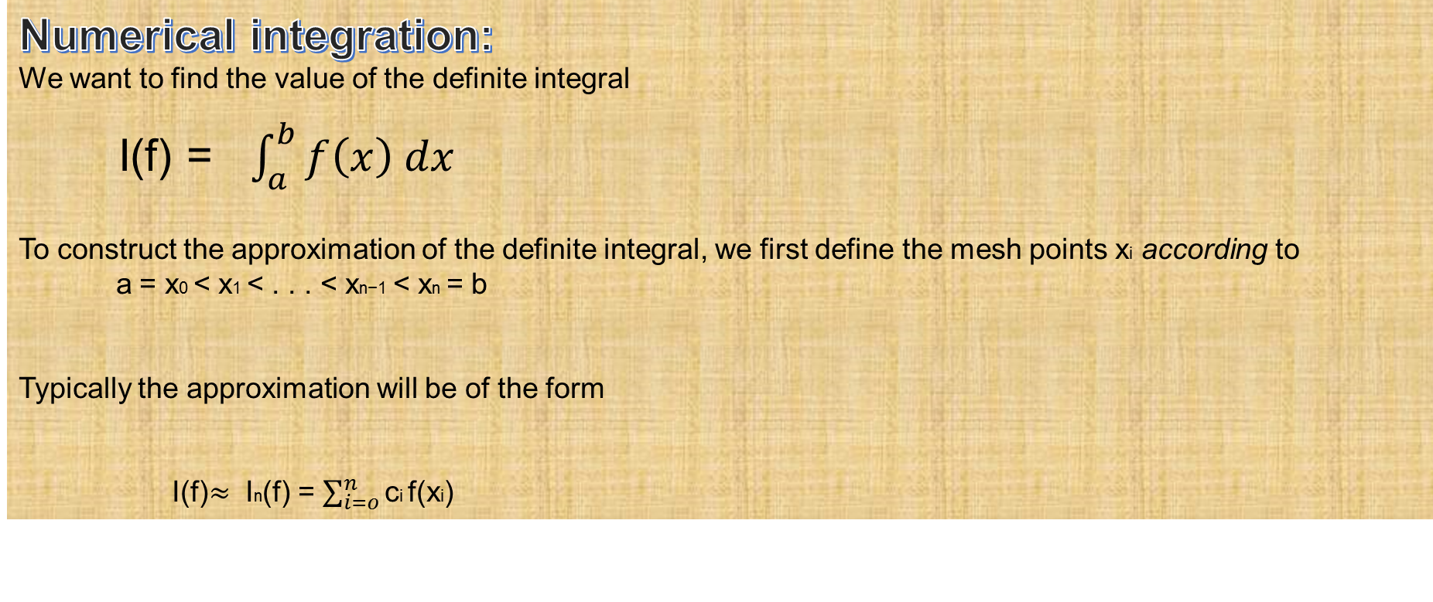
Numerical integration:
We want to find the value of the definite integral
I(f) = $\int_{a}^{b}{f\left(x\right) dx}$
To construct the approximation of the definite integral, we first define the mesh points xi accordingto
a = x0 < x1 < . . . < xn−1 < xn = b
Typically the approximation will be of the form
I(f)$≈$In(f) = $\sum_{i=o}^{n}{\text{c}\text{i} \text{f}\text{(}\text{x}\text{i}\text{) } }$

Slide 4
Trapezoidal Rule
&
Simpson’s Rule

Slide 5

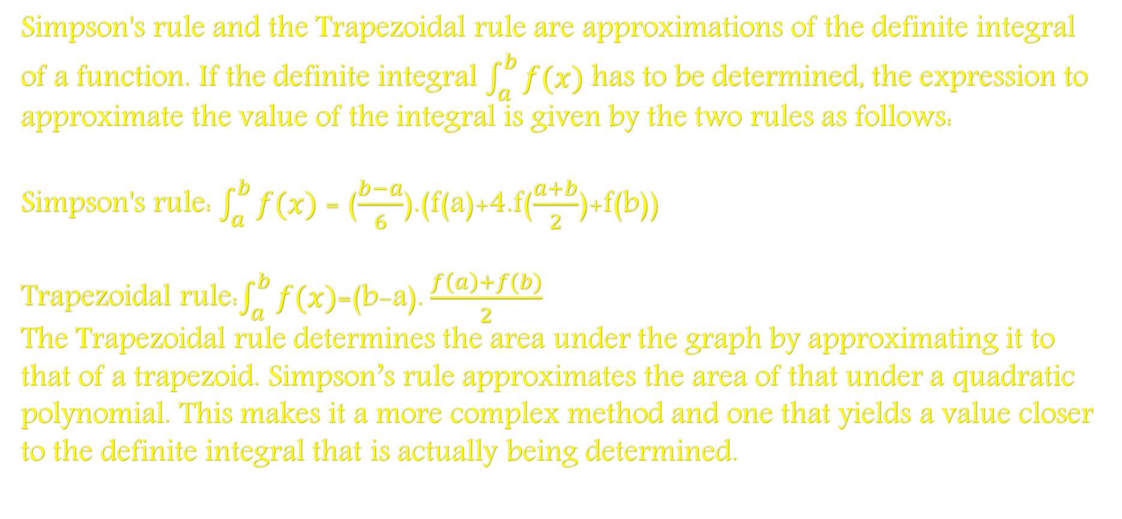
DIFFERENCE BETWEEN TRAPEZOIDAL AND SIMPSON’S
Simpson's rule and the Trapezoidal rule are approximations of the definite integral of a function. If the definite integral $\int_{a}^{b}{f(x)}$ has to be determined, the expression to approximate the value of the integral is given by the two rules as follows:
Simpson's rule: $\int_{a}^{b}{f(x)}$ = ($\frac{b−a}{6}$).(f(a)+4.f($\frac{a+b}{2}$)+f(b))
Trapezoidal rule:$\int_{a}^{b}{f(x)}$=(b-a).$\frac{f\left(a\right)+f(b)}{2}$
The Trapezoidal rule determines the area under the graph by approximating it to that of a trapezoid. Simpson’s rule approximates the area of that under a quadratic polynomial. This makes it a more complex method and one that yields a value closer to the definite integral that is actually being determined.

Slide 6

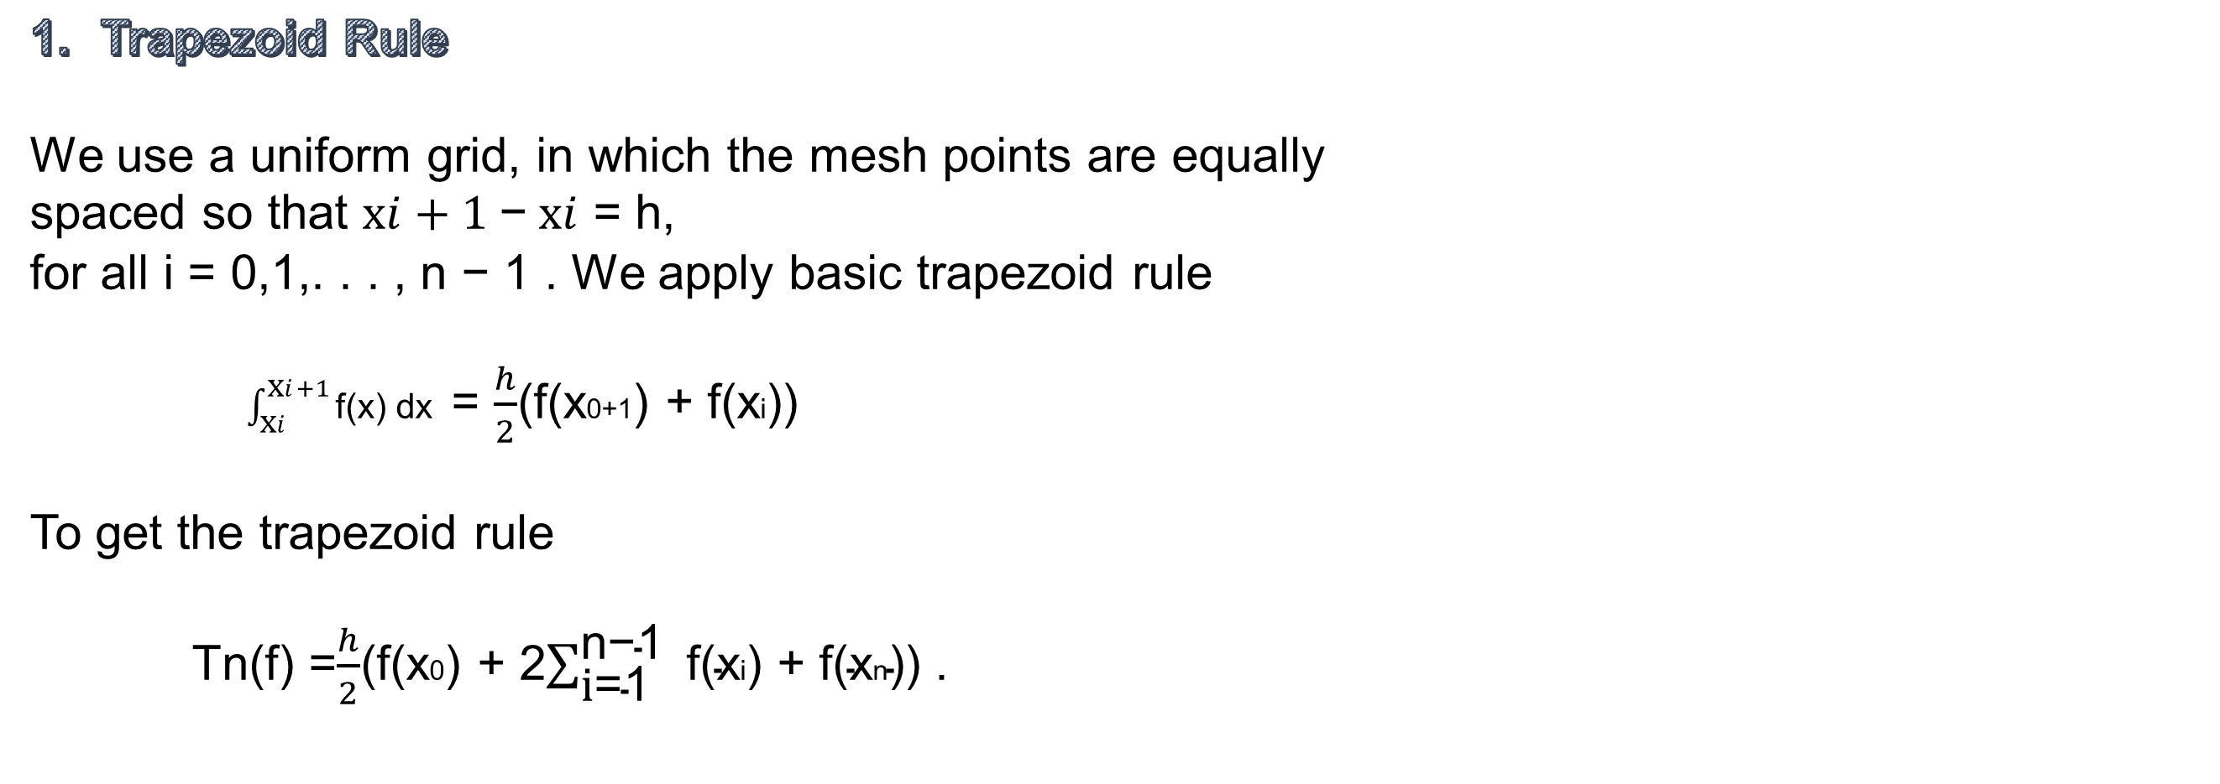
Trapezoid Rule
We use a uniform grid, in which the mesh points are equally spaced so that$\text{x}i+1$−$\text{x}i$= h,
for all i= 0,1,. . . , n − 1 . We apply basic trapezoid rule
$\int_{\text{x}i}^{\text{x}i+1}{\text{f}\text{(}\text{x}\text{) }\text{dx} }$= $\frac{h}{2}$(f(x0+1) + f(xi))
To get the trapezoid rule
Tn(f) =$\frac{h}{2}$(f(x0) + 2$\sum_{\text{i}\text{=}\text{1} }^{\text{n}\text{−}\text{1 }}{\text{f}\text{(}\text{x}\text{i}\text{) + }\text{f}\text{(}\text{x}\text{n}\text{)) }\text{.} }$

Slide 7
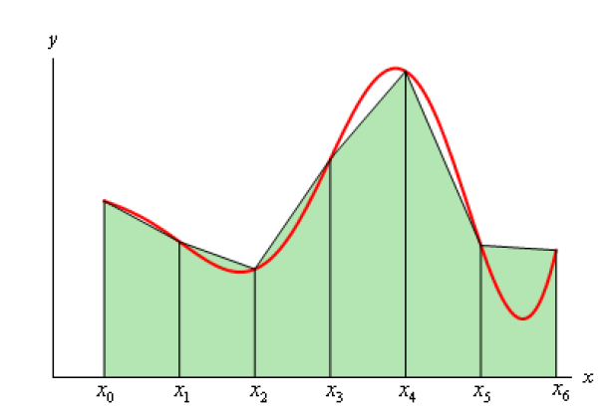
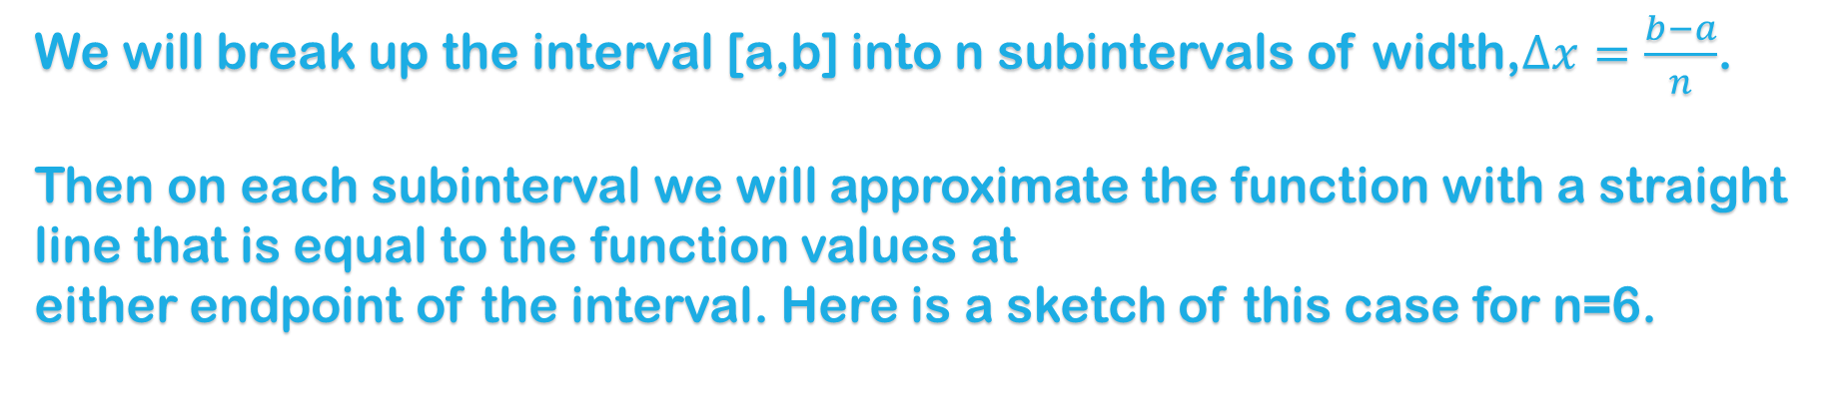
We will break up the interval [a,b] into n subintervals of width,$∆x=\frac{b−a}{n}$.
Then on each subinterval we will approximate the function with a straight line that is equal to the function values at
either endpoint of the interval. Here is a sketch of this case for n=6.
Each of these objects is a trapezoid (hence the rule's name…).

Slide 8
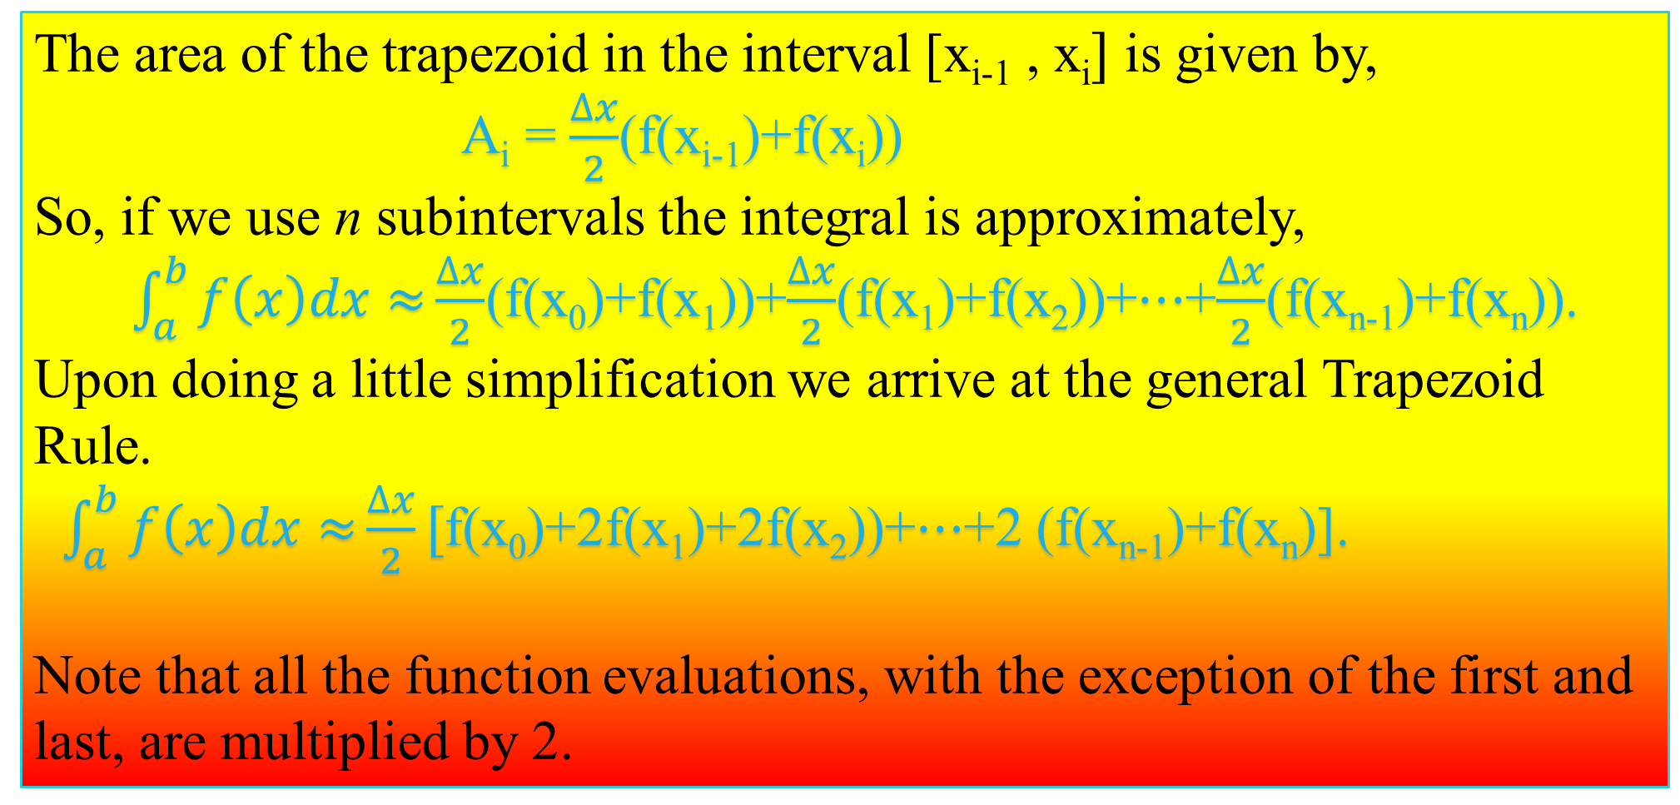
The area of the trapezoid in the interval [x_{i-1} , x_{i}$]$is given by,
A_{i} = $\frac{∆x}{2}$(f(x_{i-1})+f(x_{i}))
So, if we use n subintervals the integral is approximately,
$\int_{a}^{b}{f\left(x\right)dx≈}\frac{∆x}{2}$(f(x₀)+f(x₁))+$\frac{∆x}{2}$(f(x₁)+f(x₂))+$⋯$+$\frac{∆x}{2}$(f(x_{n-1})+f(x_{n})).
Upon doing a little simplification we arrive at the general Trapezoid Rule.
$\int_{a}^{b}{f\left(x\right)dx≈}\frac{∆x}{2}[$f(x₀)+2f(x₁)+2f(x₂))+$⋯$+2 (f(x_{n-1})+f(x_{n})].
Note that all the function evaluations, with the exception of the first and last, are multiplied by 2.

Slide 9
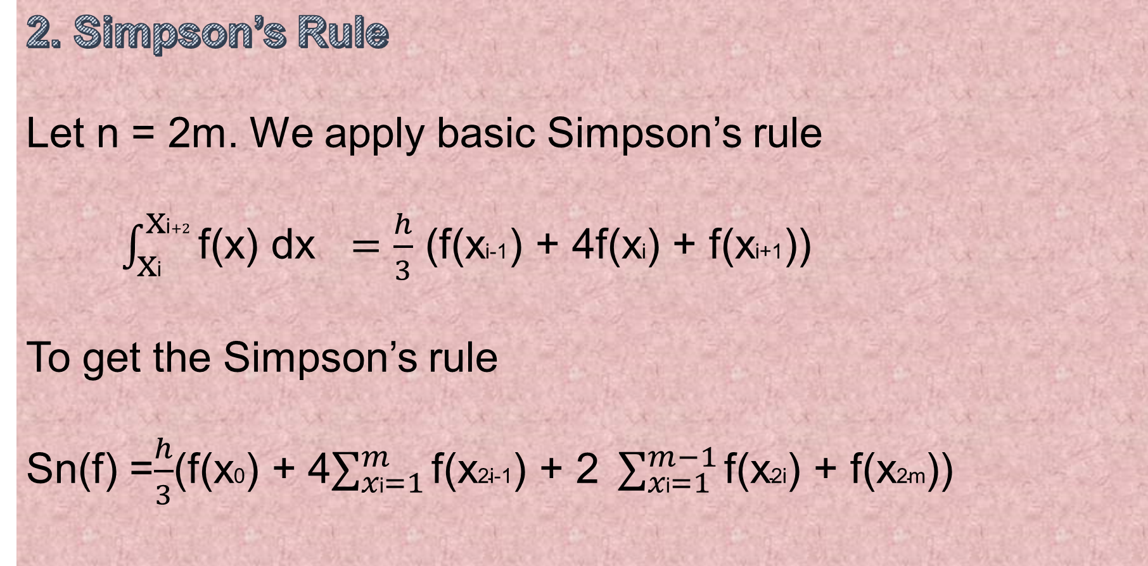
2. Simpson’s Rule
Let n = 2m. We apply basic Simpson’s rule
$\int_{\text{x}\text{i}}^{\text{x}\text{i}+2}{\text{f}\text{(}\text{x}\text{) }\text{dx} }=\frac{h}{3}$(f(x$\text{i}\text{−1}$) + 4f(x$\text{i}$) + f(x$\text{i}\text{+1}$))
To get the Simpson’s rule
Sn(f) =$\frac{h}{3}$(f(x$\text{0}$) + 4$\sum_{x\text{i}=1}^{m}{\text{f}\text{(}\text{x}\text{2}\text{i}\text{−1}\text{) + 2 }}\sum_{x\text{i}=1}^{m−1}{\text{f}\text{(}\text{x}\text{2}\text{i}\text{) + }\text{f}\text{(}\text{x}\text{2}\text{m}\text{))}}$

Slide 10
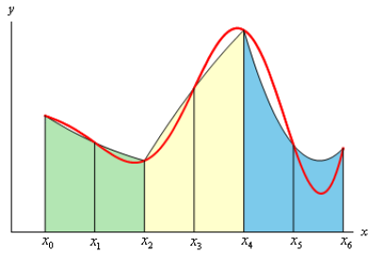
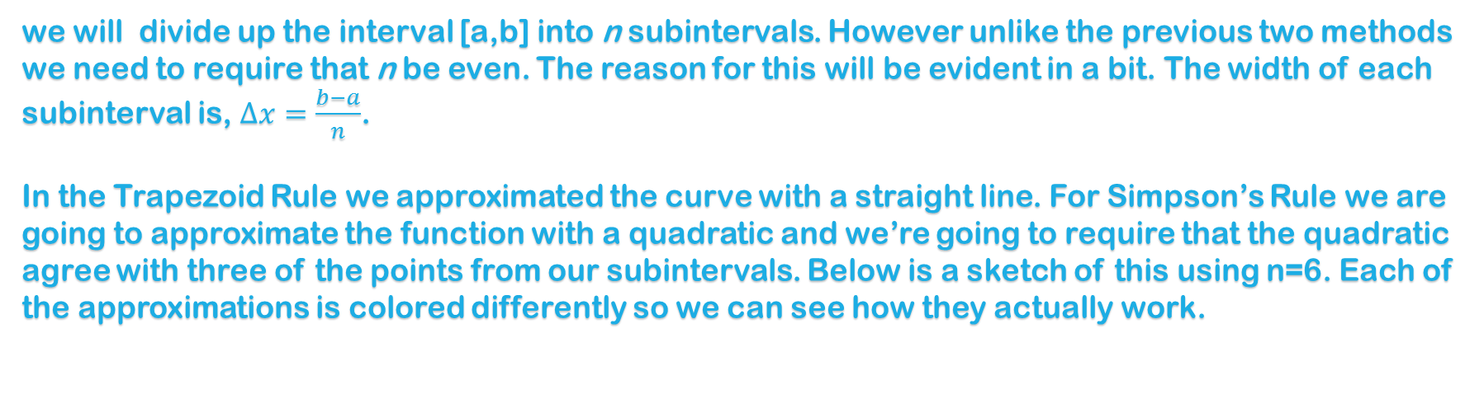
we will divide up the interval [a,b]into n subintervals. However unlike the previous two methods we need to require that n be even. The reason for this will be evident in a bit. The width of each subinterval is,$∆x=\frac{b−a}{n}$.
In the Trapezoid Rule we approximated the curve with a straight line. For Simpson’s Rule we are going to approximate the function with a quadratic and we’re going to require that the quadratic agree with three of the points from our subintervals. Below is a sketch of this using n=6. Each of the approximations is colored differently so we can see how they actually work.

Slide 11
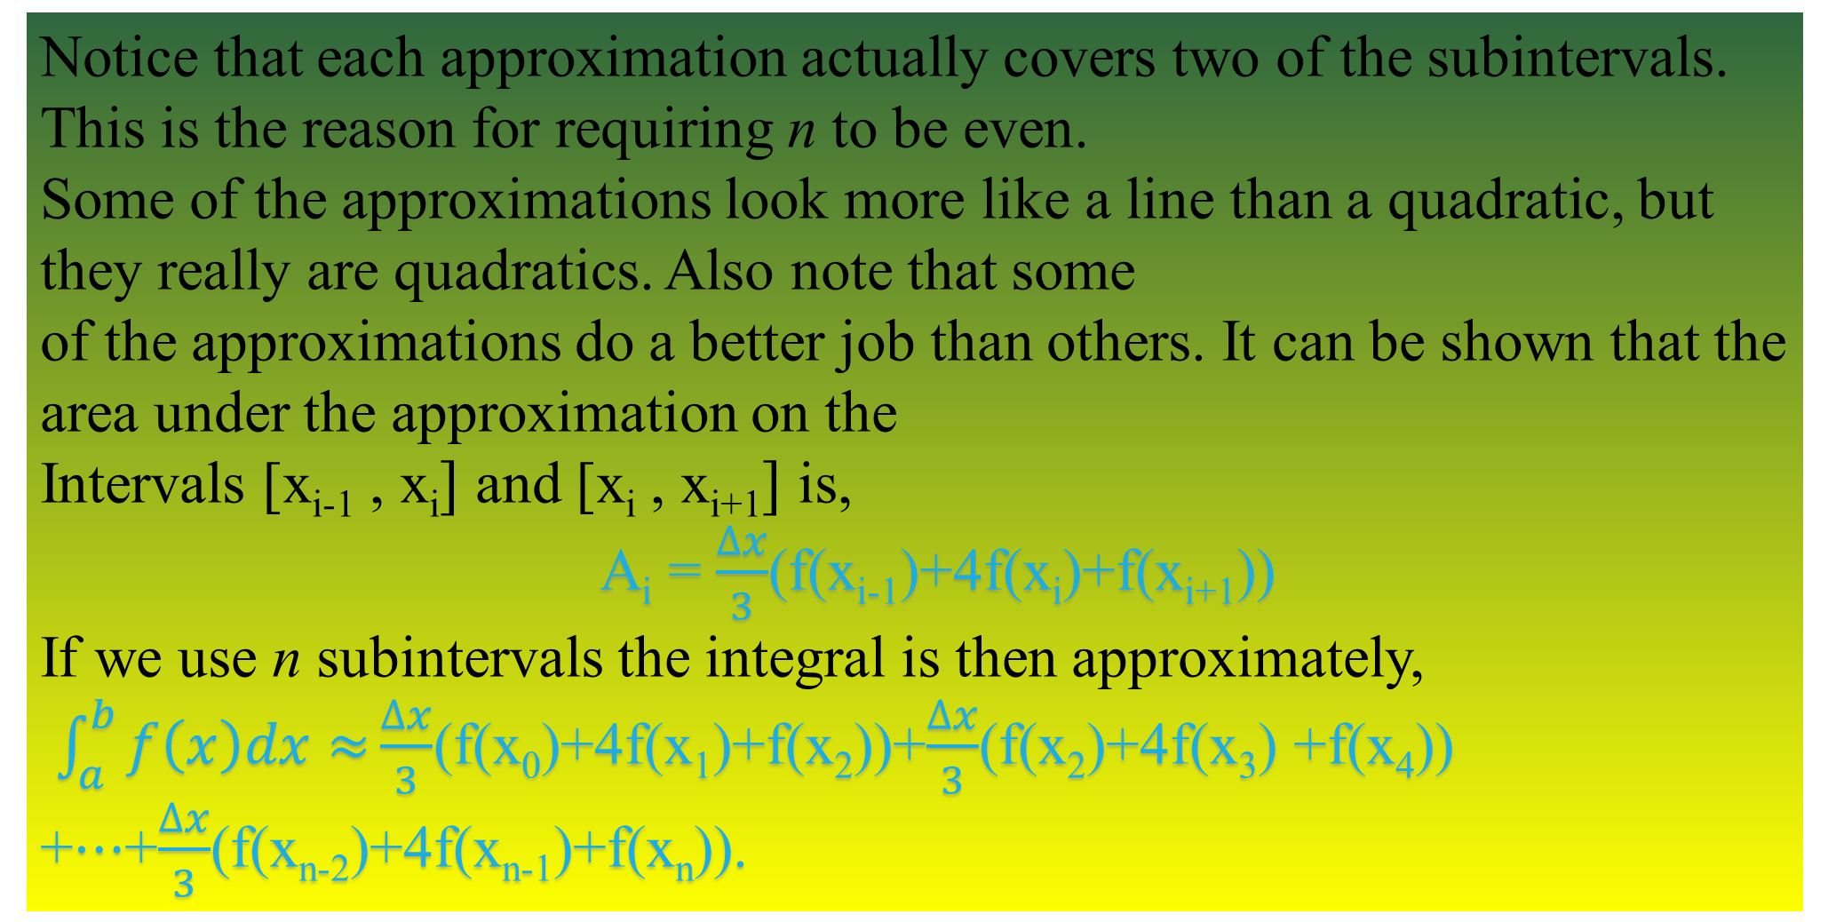
Notice that each approximation actually covers two of the subintervals. This is the reason for requiring n to be even.
Some of the approximations look more like a line than a quadratic, but they really are quadratics. Also note that some
of the approximations do a better job than others. It can be shown that the area under the approximation on the
Intervals [x_{i-1} , x_{i}$]$and [x_{i}, x_{i+1}$]$is,
A_{i} = $\frac{∆x}{3}$(f(x_{i-1})+4f(x_{i})+f(x_{i+1}))
If we use n subintervals the integral is then approximately,
$\int_{a}^{b}{f\left(x\right)dx≈}\frac{∆x}{3}$(f(x₀)+4f(x₁)+f(x₂))+$\frac{∆x}{3}$(f(x₂)+4f(x₃)+f(x₄)) +$⋯$+$\frac{∆x}{3}$(f(x_{n-2})+4f(x_{n-1})+f(x_{n})).

Slide 12
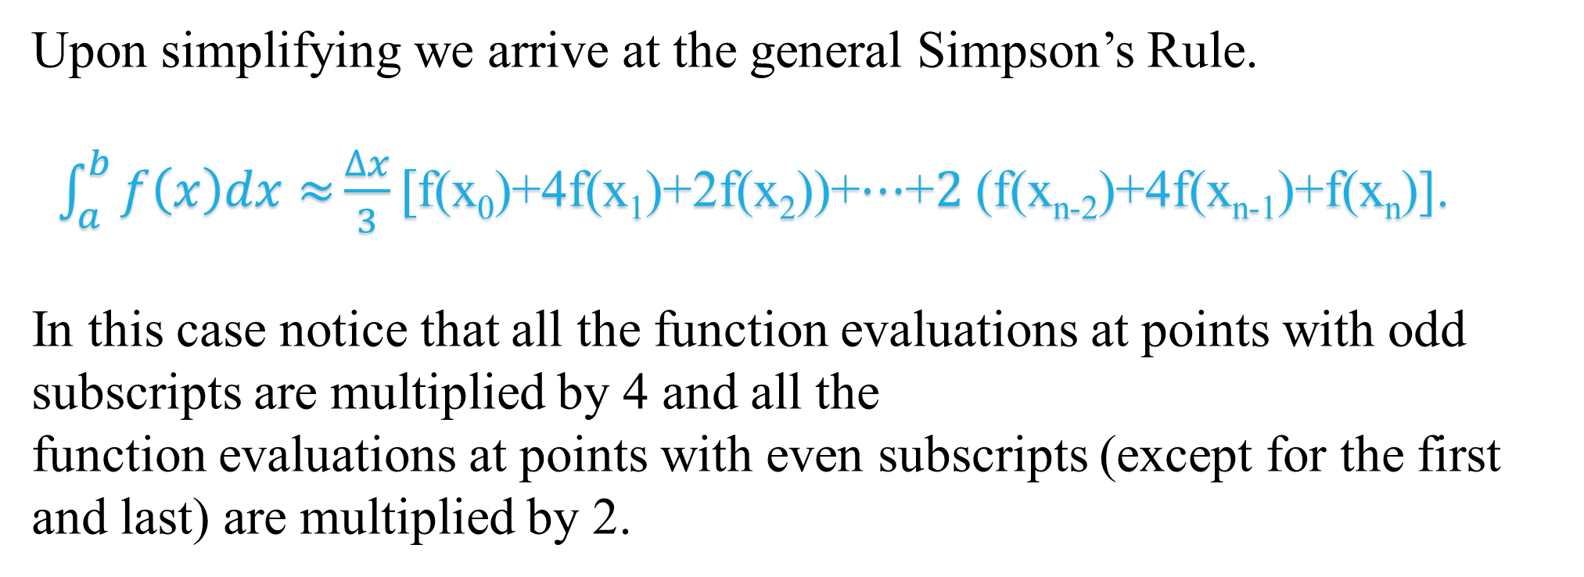
Upon simplifying we arrive at the general Simpson’s Rule.
$\int_{a}^{b}{f\left(x\right)dx≈}\frac{∆x}{3}[$f(x₀)+4f(x₁)+2f(x₂))+$⋯$+$2$(f(x_{n-2})+4f(x_{n-1})+f(x_{n})].
In this case notice that all the function evaluations at points with odd subscripts are multiplied by 4 and all the
function evaluations at points with even subscripts (except for the first and last) are multiplied by 2.

Slide 13

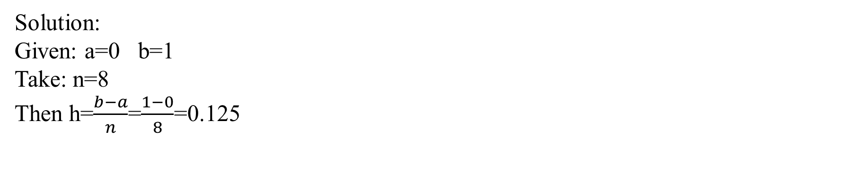
Using Trapezoidal rule and Simpson’s rule to compute $\int_{0}^{1}{\frac{1}{1+x2}dx. }$
Solution:
Given: a=0 b=1
Take: n=8
Then h=$\frac{b−a}{n}$=$\frac{1−0}{8}$=0.125
Tabulation:
x | 0 | 0.125 | 0.25 | 0.375 | 0.5 | 0.625 | 0.75 | 0.875 | 1
f(x)=y=$\frac{1}{1+x2}$ | 1 | 0.9846 | 0.9412 | 0.8767 | 0.8 | 0.7191 | 0.6400 | 0.5664 | 0.5

Slide 14

Trapezoidal Rule:
$$\int_{a}^{b}{yd\left(x\right)=\frac{h}{2}}(\left(y0+yn\right)+2\left(y1+y2+…yn−1\right)) Where y=f(x)$$
$\int_{0}^{1}{\frac{1}{1+x2}dx= }\frac{0.125}{2}$((1+0.5)+2(0.9846+0.9412+0.8767+0.8+0.7191+0.6400+0.5664))
=0.7848
Simpson’s Rule:
$$\int_{a}^{b}{yd\left(x\right)=\frac{h}{2}}(\left(y0+yn\right)+4\left(y1+y3+…yn−1\right)+2(y2+y4+yn−2)) Where y=f(x)$$
$$\int_{0}^{1}{\frac{1}{1+x2}dx=\frac{0.125}{2}(\left(1+0.5\right)+4\left(0.9846+0.8767+0.7191+0.5664\right)+2(0.9412+0.8+0.6400) }$$
= 0.7860

Slide 15
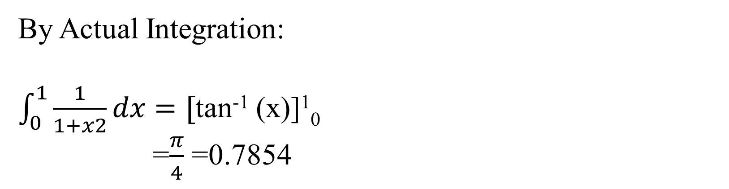
By Actual Integration:
$\int_{0}^{1}{\frac{1}{1+x2}dx}=[$tan⁻¹ (x)]¹₀ =$\frac{π}{4}$ =0.7854
Actual Integration | Trapezoidal | Simpson’s
0.7854 | 0.7847 | 0.7858
Hence the level of error is minimum in case of Simpson’s than Trapezoidal.

Slide 16
Conclusion:
In general Simpson's rule is more efficient, if by efficient means having a smaller error for the same number of intervals.

Slide 17

Thank you

